Slide 1
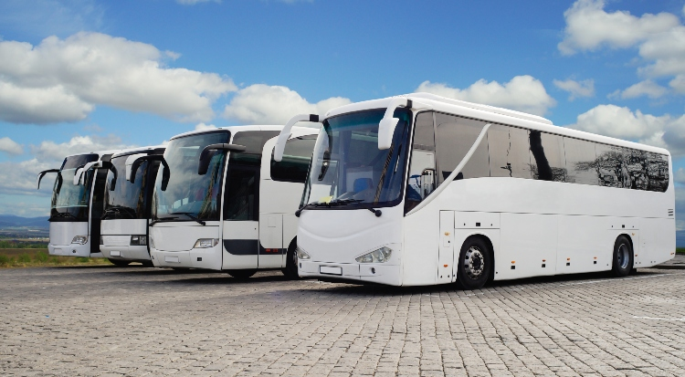
BUS COMPANY SCENARIO
Justice Inkoom

Slide 2
SCENARIO
A bus company believes that it will need the following number of bus drivers during each of the next five years: 60 drivers in year 1, 70 drivers in year 2, 50 drivers in year 3, 65 drivers in year 4; and 75 drivers in year 5.
At the beginning of each year, the bus company must decide how many new drivers to hire and how many current drivers to fire. It costs $4000 to hire a new driver and $2000 to fire a current driver. A driver's salary is $10,000 per year.
At the beginning of year 1, the company has 50 drivers. A driver hired at the beginning of a year can be used to meet the current year's requirements and is paid full salary for the current year.
As a consultant for the bus company, you have been asked to determine how to minimize the bus company's total costs (which include salary, hiring, and firing costs) over the next five years.

Slide 3
LINEAR PROG. MODEL
Decision variables:
Objective
Y1_hired | Y1_fired | Y2_hired | Y2_fired | Y3_hired | Y3_fired | Y4_hired | Y4_fired | Y5_hired | Y5_fired
10 | 0 | 10 | 0 | 0 | 20 | 15 | 0 | 10 | 0
Objective (Min.):
hired cost/driver: | 4000
fired cost/driver: | 2000
total hired cost: | $180,000
total fired cost: | $40,000
annual salary/driver | $10,000
total company cost: | $3,420,000
 | no. of drivers | Salary
Year 1 | 60 | $600,000
Year 2 | 70 | $700,000
Year 3 | 50 | $500,000
Year 4 | 65 | $650,000
Year 5 | 75 | $750,000
 | total salary: | $3,200,000

Slide 4
LINEAR PROG. MODEL CONT’D.
Constraints:
Constraints |  |  |  |  |  |  |  |  |  |  | LHS | SIGN | RHS
Year 1 | 1 | 1 |  |  |  |  |  |  |  |  | 60 | >= | 60
Year 2 |  |  | 1 | 1 |  |  |  |  |  |  | 70 | >= | 70
Year 3 |  |  |  |  | 1 | 1 |  |  |  |  | 50 | >= | 50
Year 4 |  |  |  |  |  |  | 1 | 1 |  |  | 65 | >= | 65
Year 5 |  |  |  |  |  |  |  |  | 1 | 1 | 75 | >= | 75

Slide 5
QUESTIONS
How many decision variables are in this problem?
Answer: 10
How many constraints exist in this problem?
Answer: 5
What is the minimum total cost of the company over 5 years?
Answer: $ 3,420,000.00

Slide 6
SUMMARY
At the start of year 1, hire 10 drivers and fire 0 drivers.
At the start of year 2, hire 10 drivers and fire 0 drivers.
At the start of year 3, hire 0 drivers and fire 20 drivers.
At the start of year 4, hire 15 drivers and fire 0 drivers.
At the start of year 5, hire 10 drivers and fire 0 drivers.
This will result in a minimum total cost of $3,420,000 over the next five years.

Slide 7

THANK YOU

